Slide 1


CS-3002: Information Security
Lecture # 6: Public Key Encryption
Prof. Dr. Sufian Hameed
Department of Computer Science
FAST-NUCES

Slide 2
Overview
What will you learn today
Public Key Encryption
Definition and Security
RSA Trapdoor
ISO Standard for RSA public key encryption

Slide 3
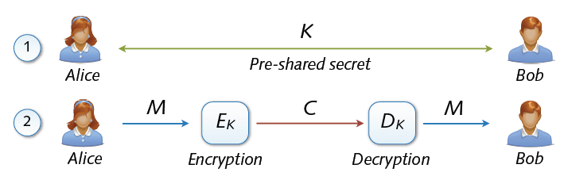
Key Exchange
Symmetric cryptosystems secure and efficient, but ...
Precondition: secure exchange of keys in advance
Paradox situation at a first glance
secure communication depends on secure key exchange

Slide 4
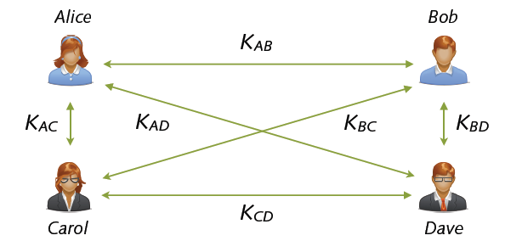
Multi-party Key Exchange
Involved multi-party key exchange with symmetric keys
Quadratic growths: n parties → (n2 - n) / 2 keys
Problem rooted in symmetry (shared keys). Alternatives?

Slide 5
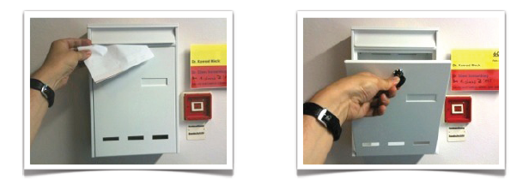
Asymmetric Keys
Solution: Two types of keys
public key pk (K+) = enables encryption but no decryption
Private/secret key sk (K–) = used for decryption only
Hard to deduce secret from public key
... similar to a classic mailbox

Slide 6
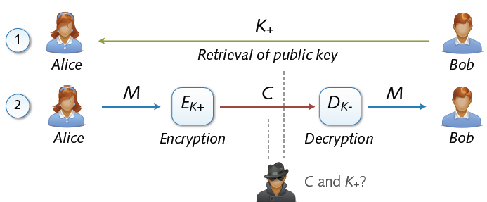
Asymmetric Cryptosystem
Asymmetric cryptosystems
Asymmetric encryption and decryption
K+ (pk) = public key of Bob K– (sk) = secret key of Bob
No secure key exchange necessary

Slide 7
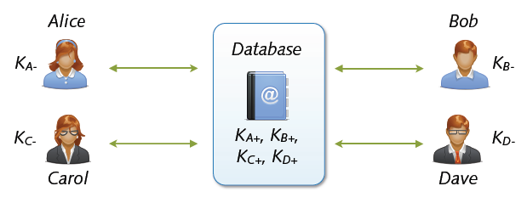
Key Exchange with Public Keys
Scalable communication with multiple parties
Linear number of exchanges: n parties → n public keys
Real-world systems with millions of keys (e.g. PGP)
... for the moment everything is fine

Slide 8
Applications
Session setup (for now, only eavesdropping security)
Non-interactive applications: (e.g. Email)
Bob sends email to Alice encrypted using pk_{alice}
Note: Bob needs pk_{alice} (public key management)
Alice
pk
Bob
Generate (pk, sk)
choose random x
(e.g. 48 bytes)
E(pk, x)
x

Slide 9
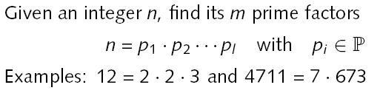
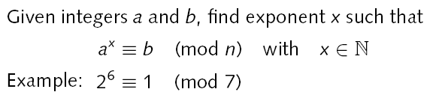
Hard Problems
Integer factorization
Discrete logarithm
Hardness: No polynomial-time algorithms known yet

Slide 10
Trapdoor One-way Functions
One-way function F(x) = y based on hard problem
Given input x: F(x) easy to compute
Given output y: hard to find input x with F(x) = y
Basis for asymmetry of public-key algorithms
Trapdoor one-way function F(x) = y
Given y and some secret: easy to find x with F(x) = y
Examples of secrets: prime factors, discrete logarithm
Basis for private key and decryption

Slide 11
Public Key Encryption
Def: a public-key encryption system is a triple of algs.(G, E, D)
G(): randomized alg. outputs a key pair (pk, sk)
E(pk, m): randomized alg. that takes m∈M and outputs c ∈C
D(sk,c): det. alg. that takes c∈C and outputs m∈M or ⊥
Consistency: ∀(pk, sk) output by G :
∀m∈M: D(sk, E(pk, m) ) = m
Notes:
In real life G actually takes security parameter like the size of the key

Slide 12
Trapdoor functions (TDF)
Def: a trapdoor func. X⟶Y is a triplet of efficient algs. (G, F, F⁻¹)
G(): randomized alg. outputs a key pair (pk, sk)
F(pk,⋅): det. alg. that defines a function X ⟶ Y
F⁻¹(sk,⋅): defines a function Y ⟶ X that inverts F(pk,⋅)
More precisely: ∀(pk, sk) output by G
∀x∈X: F⁻¹(sk, F(pk, x) ) = x
(G, F, F⁻¹) is secure if F(pk, ⋅) is a “one-way” function:
can be evaluated, but cannot be inverted without sk
Notes:
Deterministic Algorithm. an algorithm which, given a particular input, will always produce the same output, with the underlying machine always passing through the same sequence of states.

Slide 13
Review: arithmetic mod composites
Let N = p⋅q where p,q are prime
Z_{N} = {0,1,2,…,N-1} ; (Z_{N})* = {invertible elements in Z_{N}}
Facts: x ∈ Z_{N} is invertible ⇔ gcd(x,N) = 1
Number of elements in (Z_{N})* is ϕ(N) = (p-1)(q-1) = N-p-q+1
Euler’s thm: ∀ x∈ (Z_{N})* : x^{ϕ(N)} = 1
Notes:
A random element in Z_N is *very* likely to be in Z_N^*
P and Q are roughly same size and SQRT (N) or they are on the order of square root of N
ϕ(N) = N – 2SQ(N), which is almost equal to N.
Almost all elements in Zn are invertible.

Slide 14
The RSA trapdoor permutation
First published: Scientific American, Aug. 1977.
Very widely used:
SSL/TLS: certificates and key-exchange
Secure e-mail and file systems
… many others

Slide 15
The RSA trapdoor permutation
Choose random primes p, q (≈1024 bits) and compute N = p.q
Compute Euler function ϕ(N) = (p-1)(q-1)
Choose random encryption key e with gcd (e, ϕ(N)) = 1
Compute decryption key d = e⁻¹ mod ϕ(N)
s.t. e⋅d = 1 (mod ϕ(N) )
output pk = (N, e) , sk = (N, d)
F( pk, x ): RSA(x) = x^{e} (in Z_{N}) = y
F⁻¹( sk, y) = y^{d} ; y^{d} = RSA(x)^{d} = x^{ed} = x^{kϕ(N)+1} = (x^{ϕ(N)})^{k} ⋅ x = x

Slide 16
The RSA Algorithm Example
Choose p = 3 and q = 11
Compute n = p * q = 3 * 11 = 33
Compute φ(n) = (p - 1) * (q - 1) = 2 * 10 = 20
Choose e such that 1 < e < φ(n). Let e = 7
Compute a value for d such that (d * e) % φ(n) = 1. One solution is d = 3 [(3 * 7) % 20 = 1]
Public key is (e, n) => (7, 33)
Private key is (d, n) => (3, 33)
The encryption of m = 2 is c = 2⁷ % 33 = 29
The decryption of c = 29 is m = 29³ % 33 = 2

Slide 17


Security of RSA
Main attack vectors against RSA
Decrypting ciphertext c directly:
→ Difficulty of computing roots in modular arithmetic
Deriving private key
→ Difficulty of computing prime factors from n
Security (difficulty) depends on size of prime numbers
Factorization of numbers up to 768 bits feasible
Keys with 2048 and more bits deemed secure
(that is, ~600 decimal digits)

Slide 18
Textbook RSA is insecure
Textbook RSA encryption:
public key: (N,e) Encrypt: c ⟵ m^{e} (in Z_{N})
secret key: (N,d) Decrypt: c^{d} ⟶ m
Insecure cryptosystem !!
Is not semantically secure and many attacks exist
⇒ The RSA trapdoor permutation is not an encryption scheme !

Slide 19
Public-key encryption from TDFs
(G, F, F⁻¹): secure TDF X ⟶ Y
(E_{s}, D_{s}) : symmetric auth. encryption defined over (K,M,C)
H: X ⟶ K a hash function
We construct a pub-key enc. system (G, E, D):
Key generation G: same as G for TDF

Slide 20
Public-key encryption from TDFs
(G, F, F⁻¹): secure TDF X ⟶ Y
(E_{s}, D_{s}) : symmetric auth. encryption defined over (K,M,C)
H: X ⟶ K a hash function
E( pk, m) :
x ⟵ X, y ⟵ F(pk, x)
k ⟵ H(x), c ⟵ E_{s}(k, m)
output (y, c)
D( sk, (y,c) ) :
x ⟵ F⁻¹(sk, y),
k ⟵ H(x), m ⟵ D_{s}(k, c)
output m
R

Slide 21
In pictures:
Security Theorem:
If (G, F, F⁻¹) is a secure TDF, (E_{s}, D_{s}) provides auth. enc. and H: X ⟶ K is a “random oracle” then (G,E,D) is CCA^{ro} secure.
F(pk, x)
E_{s}( H(x), m )
header
body
Notes:
Need to explain what is a random oracle. NEVER encrypt m directly with RSA.

Slide 22
Incorrect use of a Trapdoor Function (TDF)
Never encrypt by applying F directly to plaintext:
Problems:
Deterministic: cannot be semantically secure !!
Many attacks exist
E( pk, m) :
output c ⟵ F(pk, m)
D( sk, c ) :
output F⁻¹(sk, c)

Slide 23
Review: RSA pub-key encryption (ISO std)
(E_{s}, D_{s}): symmetric enc. scheme providing auth. encryption.
H: x → K where K is key space of (E_{s},D_{s})
G(): generate RSA params: pk = (N,e), sk = (N,d)
E(pk, m): (1) choose random x in Z_{N}
(2) y ← RSA(x) = x^{e} , k ← H(x)
(3) output (y , E_{s}(k,m) )
D(sk, (y, c) ): output D_{s}( H(RSA⁻¹ (y)) , c)
Notes:
AE-secure: the scheme provides Authenticated Encryption.
Resulting system is chosen ciphertext secure (in the random oracle model).

Slide 24
Key lengths
Security of public key system should be comparable to security of symmetric cipher:
RSA
Cipher key-size Modulus size
80 bits 1024 bits
128 bits 3072 bits
256 bits (AES) 15360 bits

Slide 25
Implementation attacks
Timing attack: [Kocher et al. 1997] , [BB’04] The time it takes to compute c^{d} (mod N) can expose d
Power attack: [Kocher et al. 1999) The power consumption of a smartcard while it is computing c^{d} (mod N) can expose d.
Faults attack: [BDL’97] A computer error during c^{d} (mod N) can expose d.
A common defense:: check output. 10% slowdown.
Notes:
BB’04: Boneh-Brumley

Slide 26
Key Exchange with Public Key Encryption

Slide 27
Public key encryption
Alice
Bob
E
D
Notes:
Picture of cipher

Slide 28
Public key encryption
Def: a public-key encryption system is a triple of algs. (G, E, D)
G(): randomized alg. outputs a key pair (pk, sk)
E(pk, m): randomized alg. that takes m∈M and outputs c ∈C
D(sk,c): det. alg. that takes c∈C and outputs m∈M or ⊥
Consistency: ∀(pk, sk) output by G :
∀m∈M: D(sk, E(pk, m) ) = m

Slide 29
Establishing a shared secret
Alice
Bob
(pk, sk) ⟵ G()
“Alice”, pk
choose random
x ∈ {0,1}¹²⁸

Slide 30
Security (eavesdropping)
Adversary sees pk, E(pk, x) and wants x ∈M
Semantic security ⇒
adversary cannot distinguish
{ pk, E(pk, x), x } from { pk, E(pk, x), rand∈M }
⇒ can derive session key from x.
Note: protocol is vulnerable to man-in-the-middle

Slide 31
Insecure against man in the middle
As described, the protocol is insecure against active attacks
Alice
MiTM
Bob
(pk, sk) ⟵ G()
(pk’, sk’) ⟵ G()
“Alice”, pk
choose random
x ∈ {0,1}¹²⁸
“Bob”, E(pk, x)
“Bob”, E(pk’, x)

Slide 32
Public key encryption: constructions
Constructions generally rely on hard problems from number theory and algebra
Next module:
Brief detour to catch up on the relevant background

Slide 33
Acknowledgements
Material in this lecture are taken from the slides prepared by:
Prof. Dan Boneh (Standford)
Prof. Dr. Konrad Rieck (Uni-Göttingen)

